Slide 1
Cohort 10
2020
The Age of Electronic Invoice Processes in Government :
A comparison of eSettlements and Ohio|Buys
Carla Barner
Alice Ewing
Jared Nolletti
Kimberly Ross
Chiquita Wilson
Invoice Choice

Slide 2
In an effort for the State of Ohio to create a streamlined process that enables suppliers and agency end-users to work together in a concerted effort for goods and services to be received and paid for in a timely fashion, a choice between two distinctive platforms will need to be made: Ohio|Buys or eSettlements.

Slide 3
Ohio|Buys
Connecting Buyers and Suppliers

Slide 4
Background information discovered
What processes and steps were taken to find the ideal platform
Which platform is best

Slide 5
INTRODUCTION

Slide 6
2020- A year of transition and an evaluation of workplace practice change
Technological advances are becoming more prevalent and necessary

Slide 7
Electronic Invoicing – The present and the future
Historical and statistical data

Slide 8
What is our objective?
The use of technology to connect with suppliers is the objective that the state of Ohio would like to accomplish, by introducing eSettlements, sponsored by the Office of Budget and Management (OBM) and the PO Flip to invoice functionality within Ohio|Buys, sponsored by the Department of Administrative Services (DAS)

Slide 9
Section Divider
BACKGROUND
A new way to engage with customers from across the globe.

Slide 10
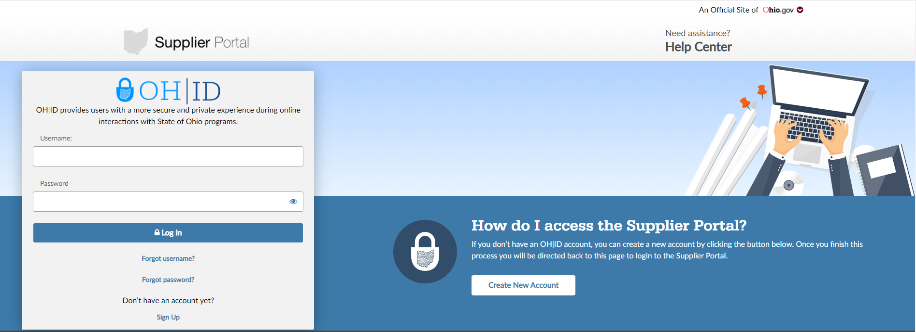
SUPPLIER PORTAL
Notes:
The Supplier portal is designed to provide suppliers with access to detailed information regarding their financial dealings with the State. This portal is user- friendly and accessible through a variety of devices. The supplier portal is a “gateway” to working with the State through either eSettlements or Ohio|Buys because all vendors need an ID number or OH|ID account for login access.

Slide 11
Notes:
Introduced in 2017, eSettlements is an online self-service solution that creates an entirely paperless system that interacts in the invoicing process. The solution will have a complete payable cycle from the submission of the invoice online through the direct deposit of the payment

Slide 12
Electronic invoicing, approvals and payments
Email notifications
Streamlines and Optimizes the Invoicing Process
Decreased turnaround time between invoicing and payment made to suppliers

Slide 13
Ohio|Buys
BACKGROUND

Slide 14
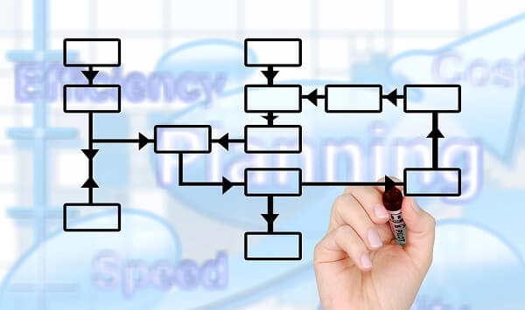
Processes
and
Functionalities

Slide 15
Analytical Supplier Dashboard
Purchase Orders, Invoices and Payments
Notes:
Users accessing eSettlements will have access to an Analytical Supplier Dashboard. Similar to PO activity generated by COGNOS except suppliers have access to this information not just the agency. The dashboard provides a view of pending invoices, Pos, remaining balances and pending payments.

Slide 16
Supplier Portal Dashboard
Pending Invoices
Purchase Orders
Remaining Balances
Pending Payments
Notes:
The dashboard provides a view of pending invoices, Pos, remaining balances and pending payments

Slide 17
eSettlements Portal for Payment
Supplier Administrator
Agency Buyer
Agency User
OAKS Account Established
EFT Information
Online Invoice
Agency Buyer receives Invoice
Invoice “Released” - creation of voucher
OAKS overnight Batch
Agency Voucher Approval Process
If no changes, Voucher approved for payment
Notes:
Once an Ohio vendor has a Supplier record in OAKS, (OH|ID, roles designated & EFT info) online invoices can be submitted to the State of Ohio through a specified agency. This process allows for overnight processing within OAKS and allows for existing policies in approval of vouchers.

Slide 18
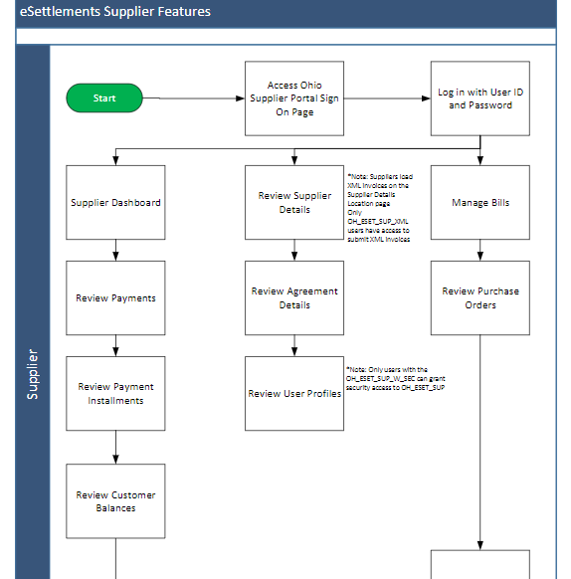

Slide 19
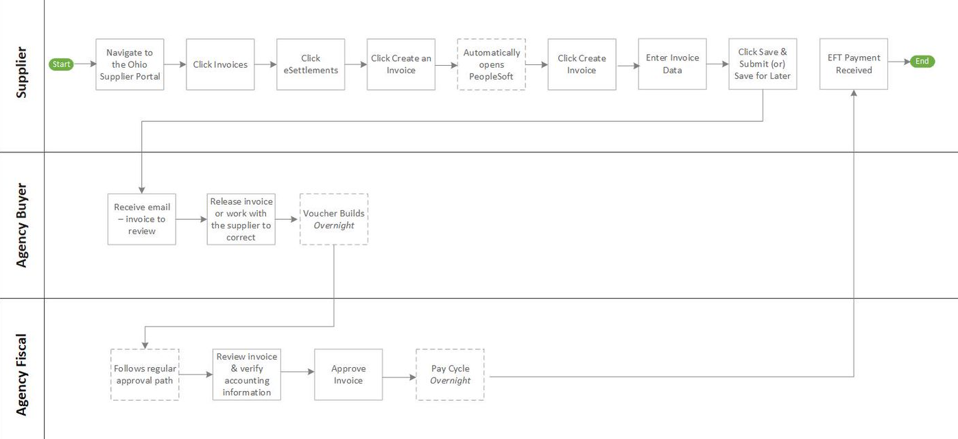

Slide 20
Ohio|Buys
Connecting Buyers and Suppliers

Slide 21
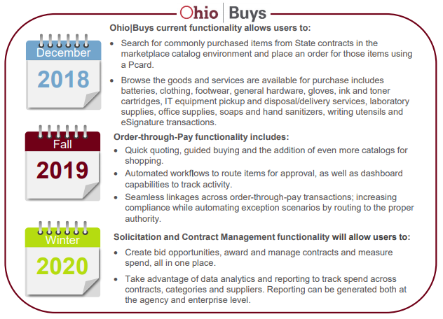
Ohio|Buys
Process & Functionalities

Slide 22
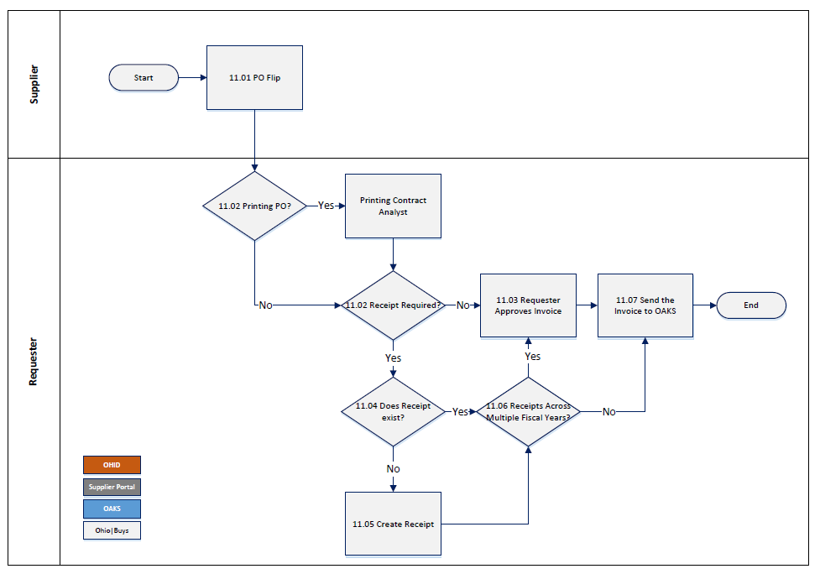
Buys
Ohio|Buys
Supplier PO Flip to Invoice

Slide 23
Highlights: eSettlements

Slide 24
REDUCE

Slide 27
Highlights: Ohio|Buys |Buys

Slide 28
Metrics/Reporting

Slide 29
System Configurability

Slide 30
Reduced Costs
Increased Productivity

Slide 31
Transparency

Slide 32
Paperless

Slide 33
Supplier Engagement

Slide 34
CHALLENGES

Slide 35
eSettlements Functional dependency on other systems
Notes:
E-Settlements is a straightforward solution but its functional dependency on other systems can be a barrier to adoption. Research indicated systemic challenges in the States core Supplier record set-up in OAKS lead to a confusing, disjointed experience to complete with the Supplier Portal.

Slide 36
eSettlements sustainability highly contingent on file upload and system integration
Notes:
XML solutions. With these sol

Slide 37
Ohio|Buys
CHALLENGES

Slide 38
Research Strategy

Slide 39
WHY DID THE STATE ADOPT EACH SYSTEM?

Slide 40
eSettlements
Transitions a paperless approach
Creates efficiencies –cutting out middleman
Fast & Secure Supplier payment

Slide 41
Ohio|Buys
Empowers both, government buyers, and interested suppliers.
Currently available to a dozen State agencies.
Will continue to grow and expand

Slide 42
WHAT BENEFITS DOES THE STATE HOPE TO GAIN USING EACH PLATFORM?

Slide 43
eSettlements One-Stop shop for Accounts Payable Maintain Sound Financial Controls Allow for Fast & Efficient Supplier Pay-terms

Slide 44
Ohio|Buys
Focus on streamlining the procurement process, allowing agencies to focus on sound fiscal practices through research and analysis, that will create an environment that optimizes the buyer supplier relationship.

Slide 45
WHAT SIGNIFICANCE DOES THE ONBOARDING PROCEDURE HAVE IN THE OVERALL PLATFORM PROCESS?

Slide 46
Suppliers Adoption State Agencies Utilization Buy-In Crucial for Success & Full Functionality
eSettlements

Slide 47
Ohio|Buys flexible onboard at a pace that makes sense for them supplier enablement continues to be an area of emphasis

Slide 48
WHAT IS THE RISK/COST
ASSOCIATED WITH
USING EACH PLATFORM?

Slide 49
eSettlements Risks
Very low Risks, if any
Supplier roles must be setup correctly

Slide 50
Ohio|Buys
Risks
Minimal risk!
Only risk is vendor missing opportunity.
No cost to the agency.

Slide 51
How does each platform capture data to inform agencies of waste, compliance or spending or does it have this capability?

Slide 52
eSettlements Compliance & Reports OAKS FIN still captures all data & generates reports

Slide 53
Ohio|Buys Bidding and purchasing can be monitored within the program. Since Ohio|Buys is still being built upon, there are new reports that will be incorporated as a capability to ensure compliance, since one point of Ohio|Buys is to collect data on purchasing.

Slide 54
FINDINGS
Ohio|Buys
eSettlements

Slide 55
Suppliers Utilizing Both Platforms were Surveyed

Slide 56
What did we learn?

Slide 57
#1- Small Sample Size
Notes:
The sample size is small and both platforms are in the beginning of production, which is not ideal for surveys, however they can be a major learning tool to identify issues in the earlier phases.

Slide 58
#2- Customer Satisfaction is currently split
Notes:
Through further vendor feedback, we can possibly identify which platform may be better recommendation for future use.

Slide 59
#3- How do we actively monitor future vendors onboarding to the new platform?
Notes:
DO we conduct more surveys? Do we contact them by phone or email?

Slide 60
#4- A decision must be made.
Notes:
At some point, a decision will need to be made to discontinue one of these platforms and transfer all efforts towards one selection. When will that happen and when will be the deadline for the decision?

Slide 61
#5- Ensuring customer service is timely and effective.

Slide 62
#6- Majority rules, Minority rights!
Notes:
Minorities have a say in majority decisions and must be heard- An unbiased decision will need to be formulated while keeping in mind, vendors currently using a certain platform.

Slide 63
Conclusion

Slide 64
eSettlements or Ohio|Buys
Notes:
DO we conduct more surveys? Do we contact them by phone or email?

Slide 65
Ohio|Buys has been recommended as our selection and for uniform use throughout Ohio.
A platform that is user friendly, reliable, cost effective, and easy to navigate is crucial.

Slide 66
Thank You
Invoice Choice

Slide 67
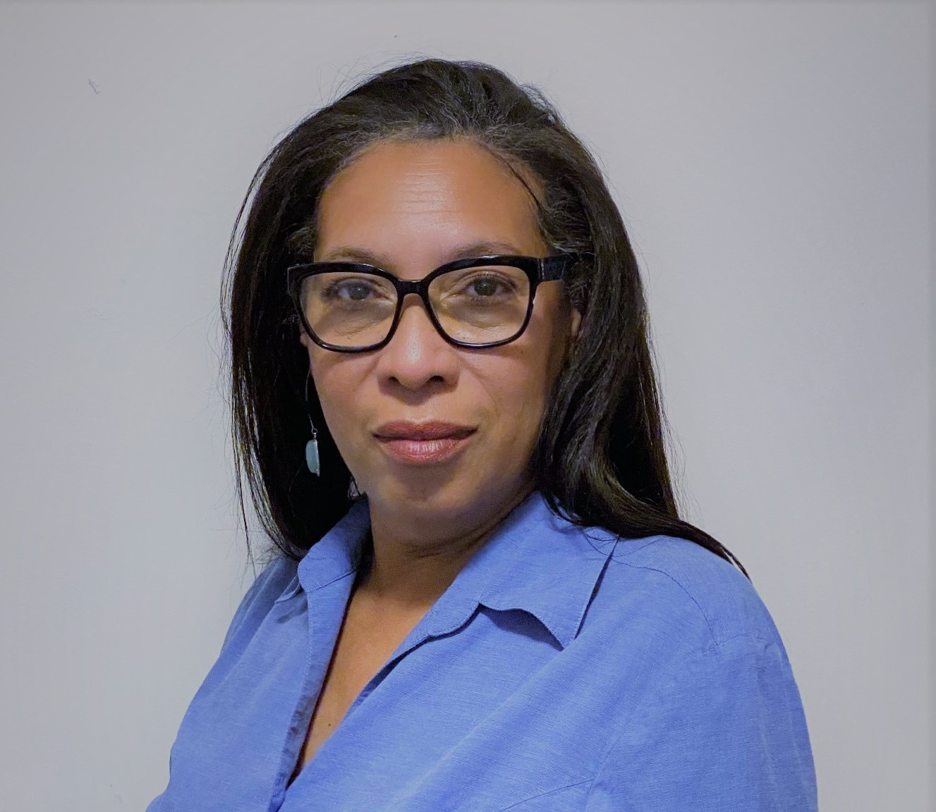
Team
Carla Barner
Kim Moorer
Senior Financial Analyst
Ohio Department of Job and Family Services
Financial Analyst
Ohio Department of Medicaid
Chiquita Wilson
Alice Ewing
Financial Program Manager
Financial Analyst
Ohio Department of Youth Services
Ohio Department of Health
Jared Nolletti
Fiscal Officer
Ohio Department of Transportation

