Slide 1
Overview of FIN Budget Structure for FY 2021
OBM
RACM (Requirements and Configuration Management)
General Ledger Team

Slide 2
OAKS Chart of Accounts
Reporting
Grant
Project
Agency Use
Service Location
Fund
Account
ALI
Department
Program
Budget Reference
Chartfields = Chart of Accounts

Slide 3
OAKS Chart of Accounts
Chartfields
Fund | Required | All Transactions
Account | Required | All Transactions
ALI | Required | Encumbrance/ Expense
Department | Required | Revenue/ Encumbrance/ Expense
Program | Required | Encumbrance/ Expense
Project | Optional* | *Required if used in an agency budget
Grant | Optional* | *Required for federal fund transactions or if used in an agency budget
Service Location | Optional* | *Required if used in an agency budget
Reporting | Optional* | *Required if used in an agency budget
Agency Use | Optional
ISTV Cross Ref | Optional
Budget Ref | Optional* | *Required if used in an agency budget
Notes:
These are actual field lengths in Core-CT, not the PeopleSoft maximum field lengths.
Project/Grant is now a required Chartfield. It is being used to enable many new Core-CT Budget Structures. Project/Grant is a required CF. Every agency has a “Non-Project” default value to use when an actual project is not being coded.
Budget Reference is also a required CF.
At this point, there shouldn’t be any more questions about what a CF is and how it’s to be used. Agencies should be finalizing their COA’s to make sure that the things that you want to Budget, Expend, and Report are captured properly.
Realignment of COA? Hopefully, not trading in the old COA for a new one.

Slide 4
Commitment Control Overview
Budgetary Control
Budgetary control is enforced on financial transactions through the use of commitment control ledgers and control options.
Distribution Lines from Transactions
Journals – GL
Purchase Orders –PO
Vouchers – AP
Travel -- TE
Commitment Control
Ledgers
Actuals Ledger
Budget Checking
Process
Journal Posting Process
Budgets
Encumbrances
Expenses
Revenue Estimates
Revenue
Assets
Liabilities
Fund Equity
Revenue
Expenses
Notes:
Budget Checking of Requisitions…..Requisition Budget Approver? After Chartfield Approval?

Slide 5
Budget Translate Tree
Account Chartfield
Budgets will be established at different levels of the Account Hierarchy
All Accounts 0
Balance Sheet 1
Income Statement 4
Revenues 40
Expenses 50
Other Sources/
Used 80
Appropriation
Payroll Personal
Services 500
Supplies &
Maint 520
Equip 530
Debt Svc 591
Allotment (Category)
Purchased
Personal Svcs 510
Payroll 5010
Edible Prod &
Food 5200
Supplies &
Materials 5210
Office Equip 5311
Debt Svcs 5910
Basic Wages
501001
Overtime
501101
Software
Pkg 521106
Data Processing
521105
Calculators
531102
Filing Cabinets
531105
Transaction Level

Slide 6
Commitment Control Overview
Budget Rules
Budget Options
Control:
Transactions that exceed the budget will error out during the budget checking process and will not post. No further processing can be performed until the amount on the transaction is reduced or the budget is increased for that Chartfield string.
Track:
Transactions that exceed the budget will pass the budget checking process with a warning message. However if the Chartfield string on the transaction does not have a budget established and posted, the budget checking process will fail.
Track without Budget:
No budget is set up and budget checking will pass.
Notes:
No control budgets at the detailed account level.
No exception warning or message on Track Budget

Slide 7
OAKS Budget Structures
Overview
CASH CONTROL
APPROPRIATION
STATE REVENUE
ESTIMATE
AGENCY REVENUE
ESTIMATE
ALLOTMENT
AGENCY CONTROL
AGENCY TRACK
Central Budgets
PROJECT
Agency Budgets
GRANT

Slide 8
Budget Maintenance (Journals)
OAKS Budget Structures
Summary - Budget Journal Maintenance
Budget Structure | Agency | Central (OBM)
Cash Control |  | Centrally maintained
State Revenue |  | Centrally maintained
Agency Revenue | Agencies enter & maintain
Appropriation |  | Centrally maintained
Allotment | Agencies enter & submit | Centrally maintained
Agency (Control & Track) | Agencies enter & maintain
Project & Grant | Agencies enter & maintain

Slide 9
Budget Ledgers & Ledger Groups
OAKS Budget Structures
Budget Structure | Ledger | Ledger Group
State Revenue | CC_STA_EST | CC_STA_REV
Agency Revenue | CC_AGY_EST | CC_AGY_REV
Appropriation | CC_APR_BUD | CC_APPROP
Allotment | CC_ALT_BUD | CC_ALLOT
Agency--Control | CC_ACT_BUD | CC_AGY_CTL
Agency--Track | CC_ATR_BUD | CC_AGY_TRK
Project | CC_PR1_BUD | CC_PROJ1
Grant | CC_GR1_BUD | CC_GRNT1
*There are additional ledgers not listed here for Encumbrances (ENC), Expenses (EXP), and Receivables (REC) and Collected (COL) ledgers for the revenue groups.

Slide 10
Questions?

Slide 11
Cash Control
OAKS Budget Structures
Explanation
Cash available prior to expenditure
Increased by revenue, decreased by expense
Always established as a control budget
Maintained centrally by OBM
Monitored by the owner of the fund (defined by Fund Attributes)
Cash Control
CASH CONTROL
STATE REVENUE
ESTIMATE
AGENCY REVENUE
ESTIMATE
APPROPRIATION
ALLOTMENT
Agency Control
Agency Track
Project
Grant
Notes:
Gregg took out “and most other non-bond funds” from the 1st bullet. Not sure why.

Slide 12
OAKS Budget Structures
Cash Control
Cash Control
Budget Keys | Budget Translation | Control ChartField | Control CF Value
Fund | ------- | X | All Funds except GRF
Updated when Transactions pass Budget Check
 | AVAILABLE CASH BALANCE
BEGINNING BALANCE | 50,000.00
REVENUE | + 500.00
EXPENSE | - 200.00
 | 50,300.00
Notes:
Discuss Budget Key fields: the Fund Control Chart Field defines the Budget Key fields – fund/deptID/class(SID); these must be non-null and unique combinations
Discuss Budget Key fields: the Fund Control Chart Field defines the Budget Key fields – fund/deptID/class(SID); these must be non-null and unique combinations

Slide 13
State Revenue Estimate
OAKS Budget Structures
Explanation
Revenue estimates by the month
Summarized at the subclass level of the Revenue Account hierarchy
High level summary available for reporting on all funds/ estimated and not estimated
Maintained centrally by OBM
State Revenue
CASH CONTROL
STATE REVENUE
ESTIMATE
AGENCY REVENUE
ESTIMATE
APPROPRIATION
ALLOTMENT
Agency Control
Agency Track
Project
Grant

Slide 14
OAKS Budget Structures
State Revenue Estimate
State Revenue
Budget Keys | Budget Translation | Control ChartField | Control CF Value
Fund | ------- | X | All Funds
Account | Subclass
Notes:
Discuss Budget Key fields: the Fund Control Chart Field defines the Budget Key fields – fund/deptID/class(SID); these must be non-null and unique combinations
Discuss Budget Key fields: the Fund Control Chart Field defines the Budget Key fields – fund/deptID/class(SID); these must be non-null and unique combinations

Slide 15
Agency Revenue Estimate
OAKS Budget Structures
Explanation
Optional revenue estimates by the month for any fund
Lowest level of the account hierarchy
Detail available for reporting on all funds/ estimated and not estimated
Maintained by the Agencies
Agency Revenue
CASH CONTROL
STATE REVENUE
ESTIMATE
AGENCY REVENUE
ESTIMATE
APPROPRIATION
ALLOTMENT
Agency Control
Agency Track
Project
Grant

Slide 16
OAKS Budget Structures
Agency Revenue Estimate
Agency Revenue
Budget Keys | Budget Translation | Control ChartField | Control CF Value
Fund | ------- | X | All Funds
Account | -------
Department | Agency
Notes:
Discuss Budget Key fields: the Fund Control Chart Field defines the Budget Key fields – fund/deptID/class(SID); these must be non-null and unique combinations
Discuss Budget Key fields: the Fund Control Chart Field defines the Budget Key fields – fund/deptID/class(SID); these must be non-null and unique combinations

Slide 17
Appropriation Budget
OAKS Budget Structures
Explanation
Legal spending authorized by the General Assembly
Highest level of expense budget in OAKS
Annual Budget Period
Always established as a control budget
Maintained centrally by OBM
APPROPRIATION
CASH CONTROL
STATE REVENUE
ESTIMATE
AGENCY REVENUE
ESTIMATE
APPROPRIATION
ALLOTMENT
Agency Control
Agency Track
Project
Grant

Slide 18
OAKS Budget Structures
Appropriation Budget
Appropriation
Budget Keys | Budget Translation | Control ChartField | Control CF Value
Fund | ------- | X | All Funds
ALI | -------
Department | Agency
Account | All Expenses
Notes:
Discuss Budget Key fields: the Fund Control Chart Field defines the Budget Key fields – fund/deptID/class(SID); these must be non-null and unique combinations
Discuss Budget Key fields: the Fund Control Chart Field defines the Budget Key fields – fund/deptID/class(SID); these must be non-null and unique combinations

Slide 19
Appropriation Example
Operating Appropriation
Budget Period | Fund | ALI | Dept (Agency) | Account (All Exp) | $$$
2021 | GRF | 477321 | DYS | 50 | 1,000,000
2021 | GRF | 470401 | DYS | 50 | 7,000,000

Slide 20
Allotment Budget
OAKS Budget Structures
Explanation
Allotment
Breakdown of Appropriation by category level of the account Chartfield
2 Rulesets— Quarterly budget period for payroll account, Annual for other categories
Always established as a control budget
Agency submits / Maintained centrally by OBM
CASH CONTROL
STATE REVENUE
ESTIMATE
AGENCY REVENUE
ESTIMATE
APPROPRIATION
ALLOTMENT
Agency Control
Agency Track
Project
Grant
Notes:
Gregg took out “and most other non-bond funds” from the 1st bullet. Not sure why.

Slide 21
OAKS Budget Structures
Allotment Budgets
2 Rulesets
Allotment Payroll (Account 500)
Allotment other Accounts
Budget Keys | Budget Translation | Control & Ruleset Chartfield | Control & Ruleset CF Value
Fund | ------- | Control | All Funds
ALI | -------
Department | Agency
Account | Category | Ruleset | Payroll (Quarter)
Budget Keys | Budget Translation | Control & Ruleset Chartfield | Control & Ruleset CF Value
Fund | ------- | Control | All Funds
ALI | -------
Department | Agency
Account | Category | Ruleset | Non Payroll (Annual)
Notes:
Discuss Budget Key fields: the Fund Control Chart Field defines the Budget Key fields – fund/deptID/class(SID); these must be non-null and unique combinations
Discuss Budget Key fields: the Fund Control Chart Field defines the Budget Key fields – fund/deptID/class(SID); these must be non-null and unique combinations

Slide 22
Allotment Example
Appropriation
Budget Period | Fund | ALI | Dept (Agency) | Account (All Exp) | $$$
2021 | GRF | 477321 | DYS | 50 | 7,000,000
Allotment
Budget Period
Fund
ALI
Dept (Agency)
Account (Category)
$$$
2021Q1
GRF
477321
DYS
500
1,500,000
2021Q2
GRF
477321
DYS
500
1,500,000
2021
GRF
477321
DYS
510
1,000,000
2021
GRF
477321
DYS
520
2,000,000
2021
GRF
477321
DYS
530
1,000,000

Slide 23
Questions?

Slide 24
Agency Budgets
OAKS Budget Structures
Explanation
Optional tool to manage agency budget – can be a breakdown of the Allotment Budget
Multiple Rulesets give Agencies a choice of Chartfields for budgeting. Chartfields within ruleset become required for all transactions.
All Chartfield combinations used in transactions must have a budget.
Annual budget period
Control, Track, or Track Without Budget
Maintained by the Agencies
Agency
CASH CONTROL
STATE REVENUE
ESTIMATE
AGENCY REVENUE
ESTIMATE
APPROPRIATION
ALLOTMENT
Agency Control
Agency Track
Project
Grant

Slide 25
OAKS Budget Structures
Agency Budgets
Use One
OR
Use Both
Agency Control Budget
Agency Track Budget
Agency Control Budget
Control at a High Level
Agency Track Budget
Track at a Lower Level
Choose Control or Track
Notes:
Discuss Budget Key fields: the Fund Control Chart Field defines the Budget Key fields – fund/deptID/class(SID); these must be non-null and unique combinations
Discuss Budget Key fields: the Fund Control Chart Field defines the Budget Key fields – fund/deptID/class(SID); these must be non-null and unique combinations

Slide 26
Agency Example
Control Budget Options
7 Rulesets – Control Budget Options
 | 7 Choices of Budget Key Chartfields
1 | Fund | ALI | Department | Account (Category)
2 | Fund | ALI | Department (Agency Selects) | Account (Category)
3 | Fund | ALI | Department (Agency Selects) | Account (Category) | Program
4 | Fund | ALI | Department (Agency Selects) | Account (Category) | Program (Agency Selects)
5 | Fund | ALI | Department (Agency Selects) | Account (Category) | Program (Agency Selects)
6 | Fund | ALI | Department (Agency Selects) | Account (Category) | Program (Agency Selects) | Budget Ref
7 | Fund | ALI | Department(Agency Selects) | Account (Class)
Department and Program budgets can be established at the same level that the agency will transact to, or a translate tree can be used to set a budget level and a transaction level.

Slide 27
Agency Example
Track Budget Options
13 Rulesets – Track Budget Options
 | 13 Choices of Budget Key Chartfields
1 | Fund | ALI | Department | Account (Category)
2 | Fund | ALI | Department (Agency Selects) | Account (Category)
3 | Fund | ALI | Department | Account (Class)
4 | Fund | ALI | Department (Agency Selects) | Account (Class)
5 | Fund | ALI | Department | Account (Category) | Program
6 | Fund | ALI | Department (Agency Selects) | Account (Category) | Program
7 | Fund | ALI | Department (Agency Selects) | Account (Category) | Program (Agency Selects)
8 | Fund | ALI | Department | Account (Category) |  | Reporting
9 | Fund | ALI | Department (Agency Selects) | Account (Category) |  | Reporting
Department and Program budgets can be established at the same level that the agency will transact to, or a translate tree can be used to set a budget level and a transaction level.

Slide 28
Agency Example
Track Budget Options
13 Rulesets – Track Budget Options
 | 13 Choices of Budget Key Chartfields
10 | Fund | ALI | Department | Account (Category/ OT)
11 | Fund | ALI | Department (Agency Selects) | Account (Category/ OT) | Program (Agency Selects)
12 | Fund | ALI | Department | Account (Category/ OT) |  | Reporting
13 | Fund | ALI | Department | Account (Class) |  | Service Location
Department and Program budgets can be established at the same level that the agency will transact to, or a translate tree can be used to set a budget level and a transaction level.

Slide 29
Agency Example
Control
Allotment
Budget Period | Fund | ALI | Dept (Agency) | Account (Category) | $$$
2021 | GRF | 477321 | DYS | 520 | 2,000,000
Control - Ruleset 1
Budget Period | Fund | ALI | Dept (Agency Selects) | Account (Category) | $$$
2021 | GRF | 477321 | DYS100000 | 520 | 1,500,000
2021 | GRF | 477321 | DYS200000 | 520 | 1,000,000
Notice the Agency Control Budget exceeds the Allotment for GRF 477321

Slide 30
Agency Example
Track
Allotment
Budget Period | Fund | ALI | Dept (Agency) | Account (Category) | $$$
2021 | GRF | 477321 | DYS | 520 | 2,000,000
Track - Ruleset 3
Budget Period | Fund | ALI | Dept (Agency Selects) | Account (Category) | Program (Agency Selects) | $$$
2021 | GRF | 477321 | DYS101000 | 520 | 5010B | 750,000
2021 | GRF | 477321 | DYS101000 | 520 | 5020B | 250,000
2021 | GRF | 477321 | DYS201000 | 520 | 5010B | 500,000
2021 | GRF | 477321 | DYS202000 | 520 | 5010B | 500,000

Slide 31
Agency Example
Control and Track
Allotment
Budget Period | Fund | ALI | Dept (Agency) | Account (Category) | $$$
2021 | GRF | 477321 | DYS | 520 | 2,000,000
Control – Ruleset 1
Budget Period | Fund | ALI | Dept (Agency Selects) | Account (Category) | $$$
2021 | GRF | 477321 | DYS100000 | 520 | 1,000,000
2021 | GRF | 477321 | DYS200000 | 520 | 1,000,000
Track – Ruleset 3
Budget Period | Fund | ALI | Dept (Agency Selects) | Account (Category) | Program (Agency Selects) | $$$
2021 | GRF | 477321 | DYS101000 | 520 | 5010B | 750,000
2021 | GRF | 477321 | DYS101000 | 520 | 5020B | 250,000
2021 | GRF | 477321 | DYS201000 | 520 | 5010B | 500,000
2021 | GRF | 477321 | DYS202000 | 520 | 5010B | 500,000

Slide 32
Project / Grant Budgets
OAKS Budget Structures
Explanation
Project / Grant
Cap on project expenditures
Cap on grant and match expenditures
All agencies are Track without Budget by default. Control or Track options available.
Maintained by the Agencies
No budget period—spans life of grant/projects
CASH CONTROL
STATE REVENUE
ESTIMATE
AGENCY REVENUE
ESTIMATE
APPROPRIATION
ALLOTMENT
Agency Control
Agency Track
Project
Grant
Notes:
Gregg took out “and most other non-bond funds” from the 1st bullet. Not sure why.

Slide 33
OAKS Budget Structures
Project / Grant Budgets
Project Budgets
Grant Budgets
Budget Keys | Budget Translation | Control & Ruleset ChartField | Control & Ruleset CF Value
Project | ------- | X | All Projects
Dept | Agency
Budget Keys | Budget Translation | Control & Ruleset ChartField | Control & Ruleset CF Value
Grant | ------- | X | All Grants
Fund | -------
Dept | Agency
Notes:
Discuss Budget Key fields: the Fund Control Chart Field defines the Budget Key fields – fund/deptID/class(SID); these must be non-null and unique combinations
Discuss Budget Key fields: the Fund Control Chart Field defines the Budget Key fields – fund/deptID/class(SID); these must be non-null and unique combinations

Slide 34
Project Budget Example
Project Budget
Dept (Agency) | Project | $$$
PWC | PWCCF18S | 7,000,000

Slide 35
Grant Budget Example
Grant Budget
Fund | Dept (Agency) | Grant/Prj | $$$
3090 | EDU | EDUFMG18 | 9,000,000

Slide 36
Questions?

Slide 37
Agency Examples
Scenario 1: An agency has only 1 Fund, 1 ALI in their Allotment budget. The agency uses the funding to manage 3 programs. The agency would like to track what each program spends within the ALI, especially overtime spent for each program, but does not feel there is a need to control the spending by each program. (it’s okay for any of the programs to exceed their budget as long as sum total of the programs stay within the allotment budget)
Solution: Agency chooses Agency Track 7 Ruleset. No translate tree is needed as budget loaded will use the same program values as transactions. Would load budget journal to each program and 3 digit account, with OT broken out as separate 50110 entry from account 500.

Slide 38
Agency Examples
Scenario 2: Agency has only 1 Fund, 1 ALI in their Allotment budget, but the funding is split between 3 divisions that use different DeptID values and each wants to spend more than their share.
Solution: Agency chooses Agency Control 2 Ruleset to restrict what each division can spend through controls on DeptID. A translate tree can be used if the agency wants to set a budget at a higher level and transact at a lower level, but the agency might also budget/transact at same values which would mean no translate tree is necessary.

Slide 39
Agency Examples
Scenario 3: Agency wants to monitor spending by federal fiscal year instead of state fiscal year.
Solution: Agency chooses Agency Track 8 Ruleset, with Track without Budget option so that all transactions will always pass budget check. The reporting Chartfield becomes a required field for the agency to use on all transactions, and the agency can use the Reporting Chartfield on each transaction to record which federal fiscal year the expense is for.

Slide 40
FIN Agency Budget Task
Where to find the Task and Forms:
http://obm.ohio.gov/MiscPages/Forms/default.aspx
Ruleset Selection and Translate Trees due to GL Team no later than 5/03/21. Use the 2022 Agency FIN Budget Selection template found on the OBM Forms page. No need to submit if no changes are being made.
Control and Track Budgets must be loaded & posted by the agency by 6/14/21. (Can be revised after 7/1/21)
Make your selection wisely! You are committed for the year once the configuration is set up.

Slide 41
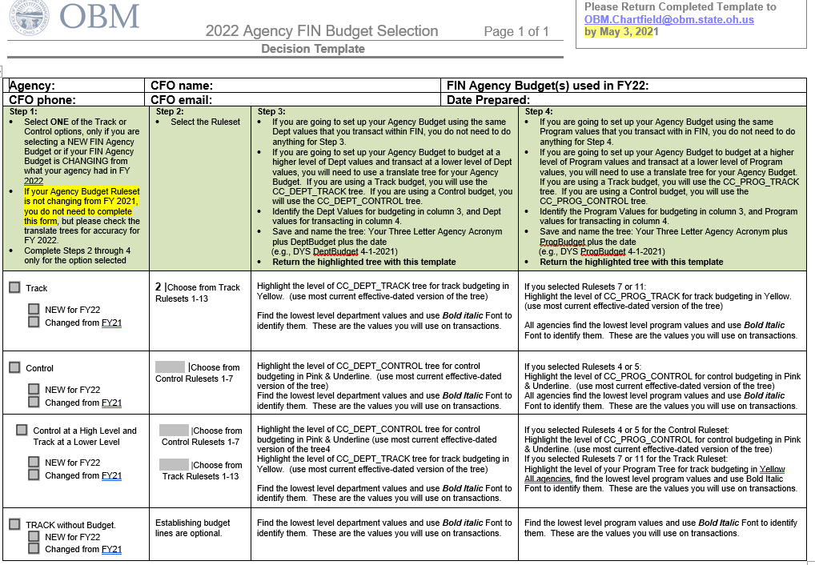
2022 Agency FIN Budget Selection Form:

Slide 42
Track Budget Selection

Slide 43
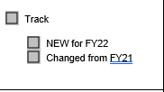
Example: Changed to Ruleset 4

Slide 44
Example of Dept Track Tree to submit

Slide 45
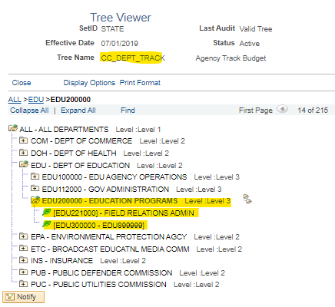
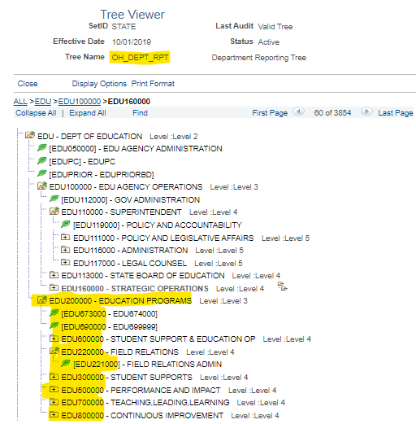
NOTE: Translate tree does not have to use the same organization as the Dept Reporting tree (OH_DEPT_RPT) for your agency.
OH_DEPT_RPT
Translate Tree

Slide 46
Control Budget Selection

Slide 47
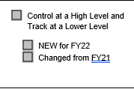
Control & Track Budget Selection

Slide 48
Track Without Budget Selection

Slide 49
Agency Budget Journals
The GL Team will send a confirmation email once the new budget Ruleset configuration is complete for your agency.
Agency must post budget by 6/14/2021
Journal date must be 7/1/2021
Ledger Group:
CC_AGY_CTL (Agency Control)
CC_AGY_TRK (Agency Track or Agency Track Without Budget)

Slide 50
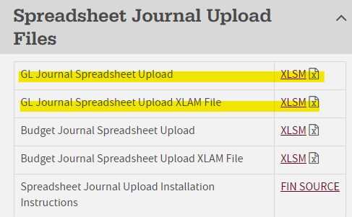
Loading Budget/GL Journals
Refer to the Spreadsheet Journal Upload Installation Instructions below.
If you have a lot of rows of data, you will want to use the Budget Journal Spreadsheet tool. It is located on https://obm.ohio.gov/wps/portal/gov/obm/areas-of-interest/agency-overview/resources/forms under the “Spreadsheet Journal Upload Files” section.
Save the highlighted files to a directory on your computer or network.

Slide 51
Chartfields
Refer to the FIN Process Manual (fin.help4u.obm.ohio.gov) under General Ledger > Steps for Chartfields
You need to have the role of OH_GL_AGY_COA_REQUESTOR or OH_GL_AGY_COA_APPROVER. It can be assigned via the FIN Online Security Form by your agency Security Designee.
EFFDT must be 1-1-1901 for all NEW chartfield values.
Chartfields must have active EFFDT on or before 7-1-2021 to use in budget journal for FY 2022 budget. (unless needed for payroll for 1st pay period of FY22, which must have 6-6-2021 EFFDT for combo code).
Chartfields can be requested through June 25, until COA security roles are turned off for year end close processing.

Slide 52
Questions?
OBM.Chartfield@obm.ohio.gov

